Slide 1
Python Comprehensions
List Set and Dictionary
Xi Wu(they/them) 09/25/2025

Slide 2
Python Comprehension
Syntax
List Comprehension
[ expression for item in iterable if condition ]
{ expression for item in iterable if condition }
{ key_expr : value_expr for item in iterable if condition }
Set Comprehension
Dictionary Comprehension

Slide 3
Python Comprehensions
What
Why
When

Slide 4
List Comprehension
What?
List comprehension is a compact syntax in Python that lets you build a new list from an existing iterable in a single line.
-Based on: Python Docs, Data Structure
- Each element can be transformed(e.g., square every number)
- Elements can also be filtered with a condition(optional)

Slide 5
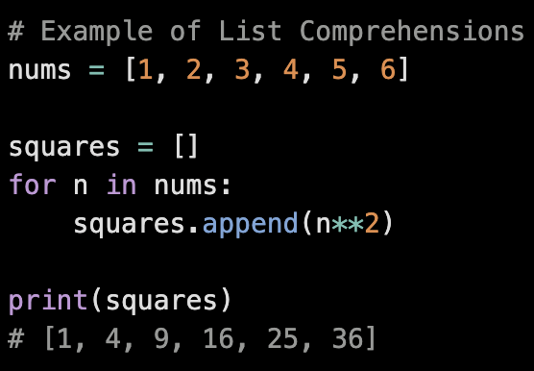
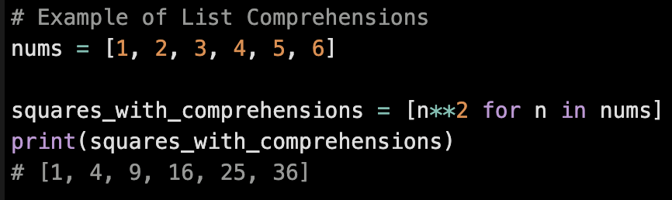
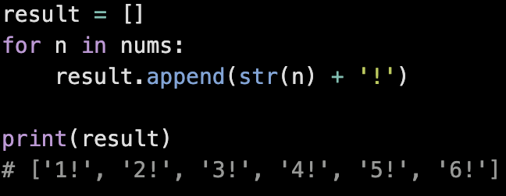
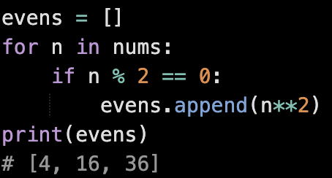
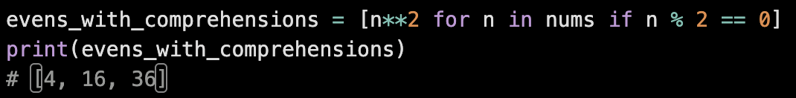
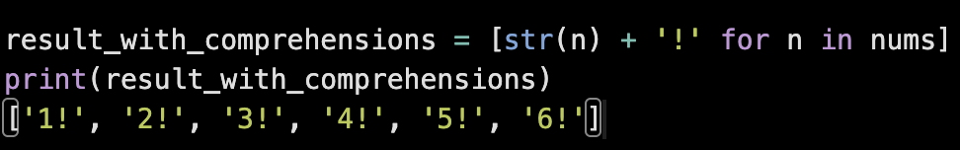
List Comprehension
Examples
Quiz

Slide 6
List Comprehension
Why?
Shorter and clearer than a traditional for loop + append()
Improves code readability
Efficient for generating or filtering lists

Slide 7
List Comprehension
When?
Create a new list from an existing one
Transform or filter elements in a concise way

Slide 8
Set Comprehension
What?
Set comprehension is a similar syntax to list comprehension, but it builds a set(unique elements) instead of a list.
-Based on: Python Docs, Data Structure 5.4 Sets

Slide 9
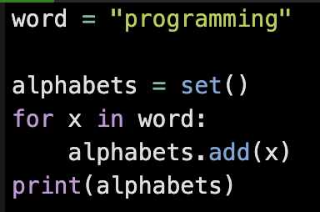
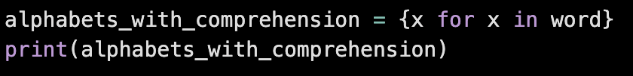


Set Comprehension
Examples
Output:
Sets in Python are unordered collections of unique elements

Slide 10
Set Comprehension
Why?
Automatically removes duplicates
Keeps code concise and readable

Slide 11
Set Comprehension
When?
Need a collection of unique unordered elements
Transforming elements while eliminating duplicates

Slide 12
Dictionary Comprehension
What?
Dictionary comprehension lets you build a dictionary from an iterable in a single line, mapping keys to values.
-Based on: Python Docs, Data Structure 5.5 Dictionaries

Slide 13
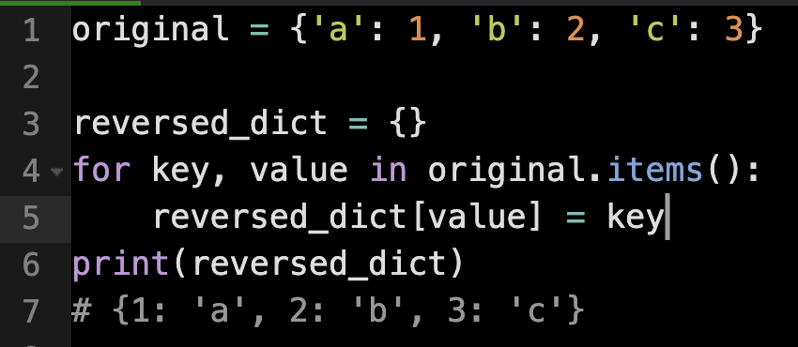
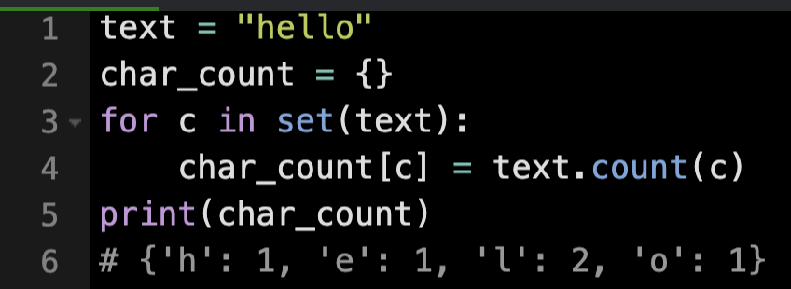
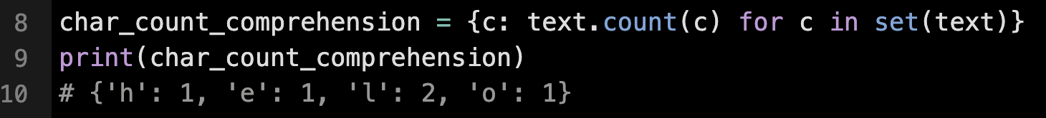
Dictionary Comprehension
Examples
c# {'h': 1, 'e': 1, 'l': 2, 'o': 1}
c# {'h': 1, 'e': 1, 'l': 2, 'o': 1}

Slide 14
Dictionary Comprehension
Why?
Concise way to create key-value pairs
Easier to read than a for-loop with assignments

Slide 15
Dictionary Comprehension
When?
Generate a dictionary quickly
Mapping or transforming data into key-value pairs

Slide 16
Python Comprehension
Syntax
List Comprehension
[ expression for item in iterable if condition ]
{ expression for item in iterable if condition }
{ key_expr : value_expr for item in iterable if condition }
Set Comprehension
Dictionary Comprehension

Slide 17
Thank You

